Slide 1
MAP-ID ~ BENGALURU
TRAINING ON
LEADERSHIP SKILLS
BY
UMASANKAR SAN
MUSASHI AUTO PARTS INDIA PVT. LTD.

Slide 2
LEADERSHIP SKILLS
Session objectives:
What is leadership?
Identify the traits and skills of an effective leader
Key leadership theories
Examine the role, duties and responsibilities of a Team Leader in the workplace
Understand the limits of authority in a Team Leader role
Develop a plan to develop your own leadership potential

Slide 3
LEADERSHIP SKILLS
Leadership:
"Leadership is a function of knowing yourself, having a vision that is well communicated,
building trust among colleagues, and taking effective action to realize your own leadership potential."
…….Prof. Warren Bennis
Leadership Theory:
Great Man Theories
Leaders are exceptional people, born with innate qualities, destined to lead
Term 'man' was intentional - concept was primarily male, military and Western
Trait Theories
Research on traits or qualities associated with leadership are numerous
Traits are hard to measure. For example, how do we measure honesty or integrity?

Slide 4
LEADERSHIP SKILLS
Leadership Traits and Skills:
Traits
Adaptable to situations
Alert to social environment
Ambitious and achievement orientated
Assertive
Cooperative
Decisive
Dependable
Dominant (desire to influence others)
Energetic (high activity level)
Persistent
Self-confident
Tolerant of stress
Willing to assume responsibility
Skills
Clever (intelligent)
Conceptually skilled
Creative
Diplomatic and tactful
Fluent in speaking
Knowledgeable about group task
Organised (administrative ability)
Persuasive
Socially skilled
Leaders will also use:
Integrity, Honesty, Compassion, Humility

Slide 5
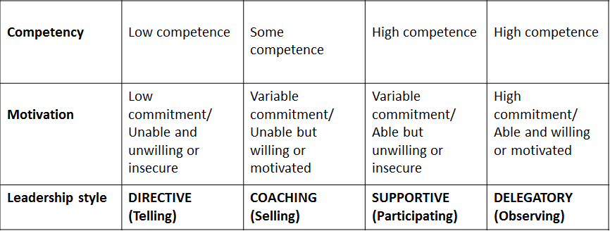
LEADERSHIP SKILLS
Leadership Theory:
Situational/contingency Leadership (Hersey-Blanchard, 1970/80) Leadership style changes according to the 'situation‘ and in response to the individuals being managed – their competency and motivation

Slide 6
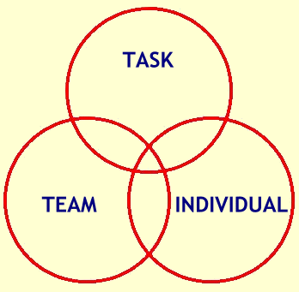
LEADERSHIP SKILLS
New Leadership Theory:
Transformational Theory
How to improve your leadership skills:
Individual Exercise:
Assess yourself as a Leader
Conduct a SWOT analysis - Strengths, Weaknesses, Opportunities, Threats
(Use the Results of Leadership Questionnaire you have been completed prior to attending the session)
Develop an Action Plan to improve as a leader
list 2 actions you will undertake to address Weaknesses or capitalise on Opportunities identified
Apply SMART targets to your actions – Specific,
Measurable, Achievable, Realistic, Time-bound
Leadership Philosophies:
Ethical Leadership
Key Team Leader Responsibilities:
Accountability, Responsibility, and Authority:
Team Leader Authority:

Slide 7
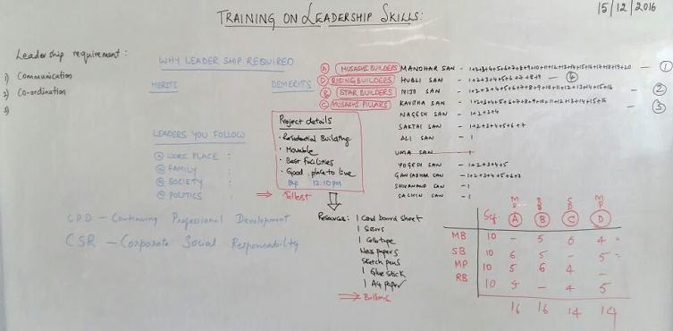
LEADERSHIP SKILLS

Slide 8
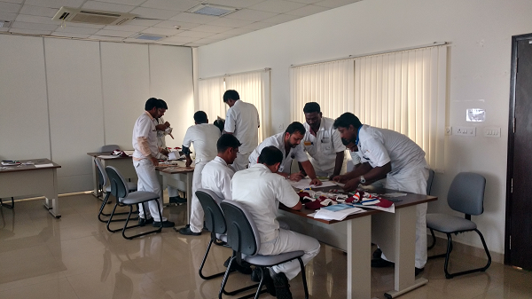
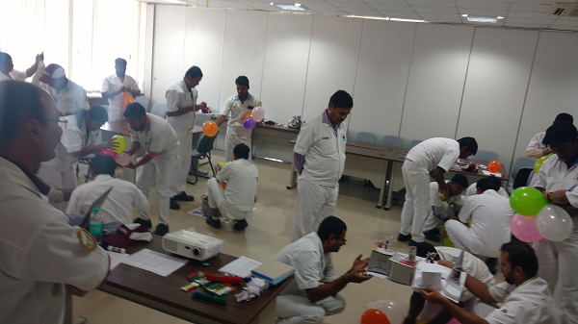
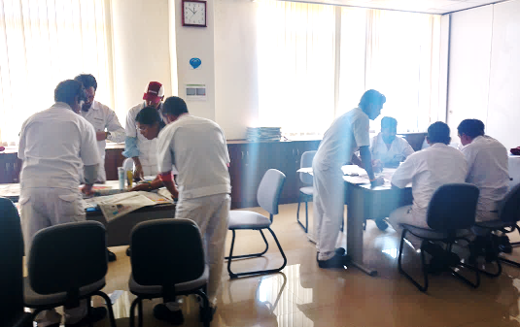
LEADERSHIP SKILLS
TEAM 1 & 2
TEAM ACTIVITY
TEAM 3 & 4

Slide 9
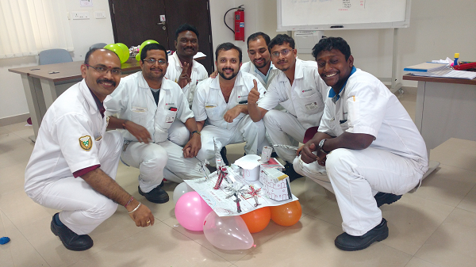
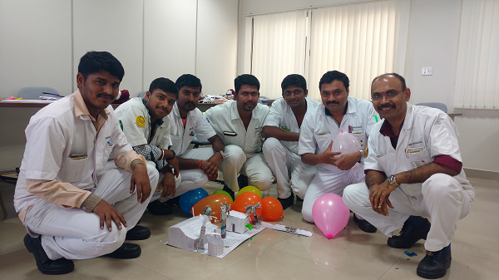
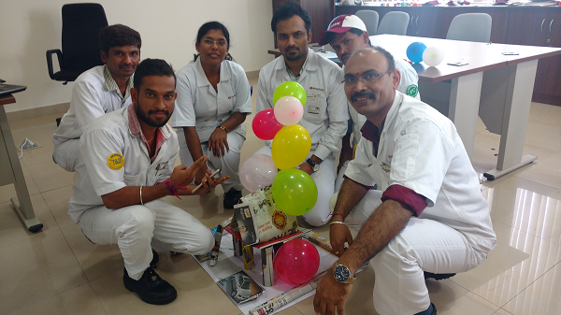
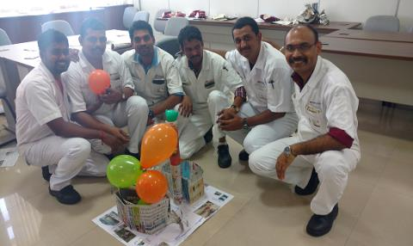
LEADERSHIP SKILLS
MUSASHI BUILDERS
STAR BUILDERS
MUSASHI PILLARS
RISING BUILDERS

Slide 10
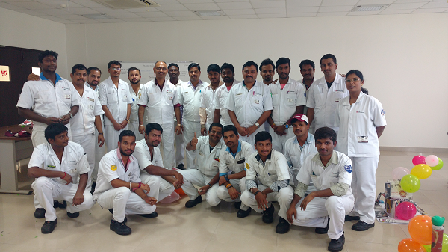
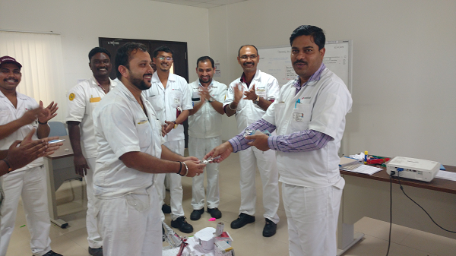
LEADERSHIP SKILLS
WINNER TEAM
MUSASHI BUILDERS
LEADERSHIP SKILLS TRAINING PARTICIPANTS GROUP PHOTO

